Slide 1
Water Quality Monitoring and Ground Water level Analysis
Project ID : W11
Capstone Project Phase 1
Capstone Project Phase 1 _ ESA
Notes:
1

Slide 2


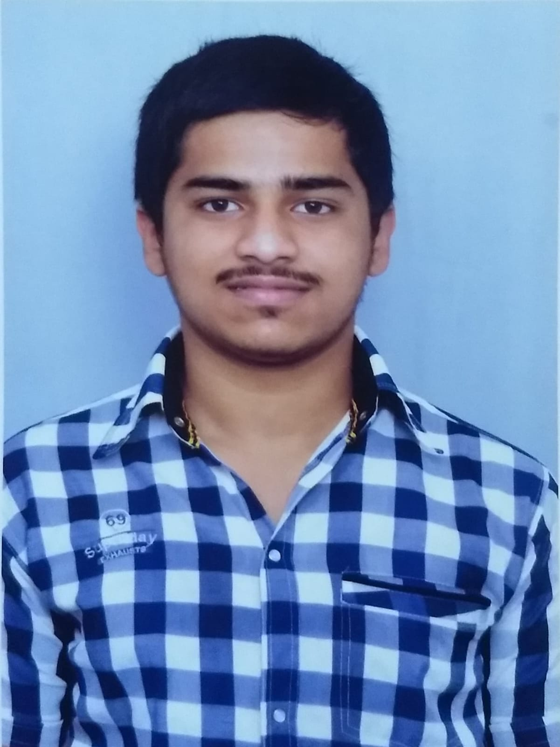

Team Composition
Sl.No. | Name | SRN | Photo
1 | Abhishek A Shetty | PES1UG21EC008
2 | Akash Chanabasu Katate | PES1UG21EC022
3 | Akash Ravi Bhat | PES1UG21EC025
4 | Tejas V P | PES1UG21EC910
Guide : Dr. Purushotham U
2

Slide 3
Outline of Presentation
Introduction & Motivation
Literature Survey
Broad Objectives
Problem Statement
Methodology
Required Hardware / Software details
Project Deliverables
References
Project timeline Gantt Chart
3

Slide 4
Introduction & Motivation
Water pollution poses serious threats to ecosystems and public health
Existing monitoring methods lack real-time data monitoring.
Integrated approach using sensors to monitor water pollution, analysing the ground level water and issue alerts for contaminated sources, addressing these shortcomings effectively.
The urgent need to enhance water quality monitoring and management drives this research.
With pollution incidents on the rise, there's a huge demand for innovative solutions that offer real time data.
Developing sensor networks, this study aims to bridge current monitoring gaps, empowering stakeholders with actionable data to reduce pollution risks.
4
Notes:
4

Slide 5
[1] K. Banerjee et al., "Assessing Water Quality Index Near Industrial Regions and Aiding in Effective Water Management and Controlling Water Pollution Level," 2022 5th International Conference on Contemporary Computing and Informatics (IC3I), Uttar Pradesh, India, 2022, pp. 1987-1991
Author’s work | The author emphasizes the correlation between industrial waste discharge and changes in crucial water quality parameters, such pH level, and temperature, highlighting their collective influence on altering the Water Quality Index (WQI)
Inference | This research presents an IoT-based solution for real-time water pollution monitoring. The system aims to improve water quality management by providing timely alerts to authorities.
Limitations | The study does not incorporate machine learning algorithms for advanced data analysis and predictive modeling. The absence of machine learning techniques may limit the system's ability to provide deeper insights and predictive capabilities for water quality management.
5

Slide 6
[2] K. S., S. T.V., M. S. Kumaraswamy and V. Nair, "IoT based Water Parameter Monitoring System," 2020 5th International Conference on Communication and Electronics Systems (ICCES), Coimbatore, India, 2020, pp. 1299-1303
Author’s work | The authors highlighted a three-layered approach for water monitoring, utilizing sensors for data acquisition, Gsm and Ethernet for transmission, and IoT platforms for processing.
Inference | -EXO Sonde will collect the data and monitoring will be done at server-side -Data from the primary controller is stored, then transmitted to the server via GSM, without real-time data due to occasional GSM connection issues.
Limitations | -The Exo Sonde is very expensive and lack of some other parameters which are affecting the quality of water -Once the data will be transmitted to the server. The timestamp will be removed. The transmission of data to the server is done through GSM. The GSM connection can’t be achieved every time, hence the real time values are not always available.
6

Slide 7
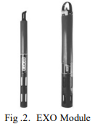
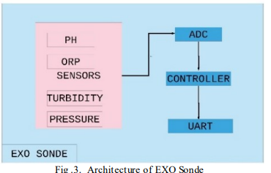
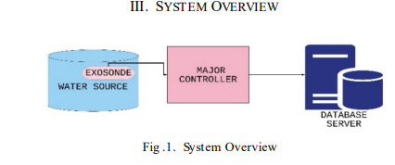
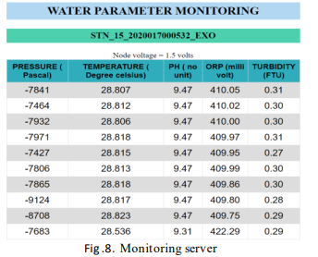
Result on server side
The smart sensor options in the EXO are conductivity, dissolved oxygen content, pH, rhodamine, total algae, and turbidity

Slide 8
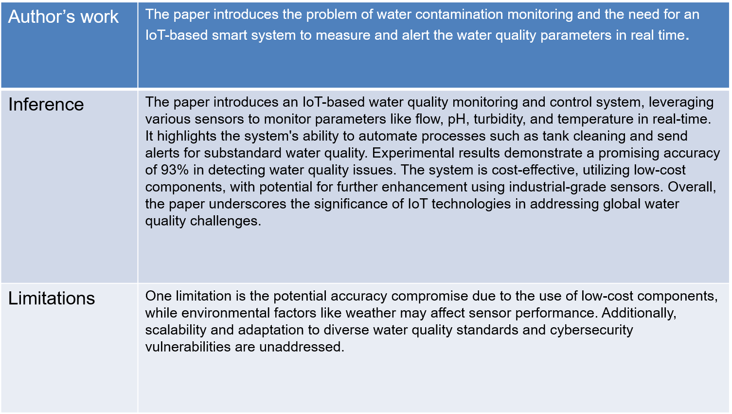
[3] Md. Jahirul Islam, Asaduzzaman, “Smart Water Quality Monitoring and Controlling System”, 5th International Conference on Electrical Information and Communication Technology (EICT), 17-19 December 2021, Khulna, Bangladesh
8

Slide 9
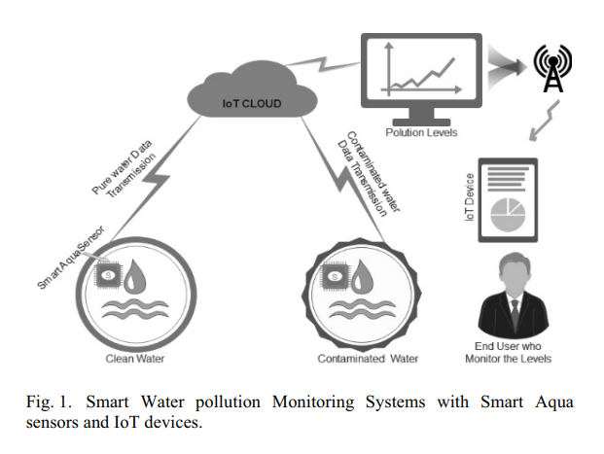
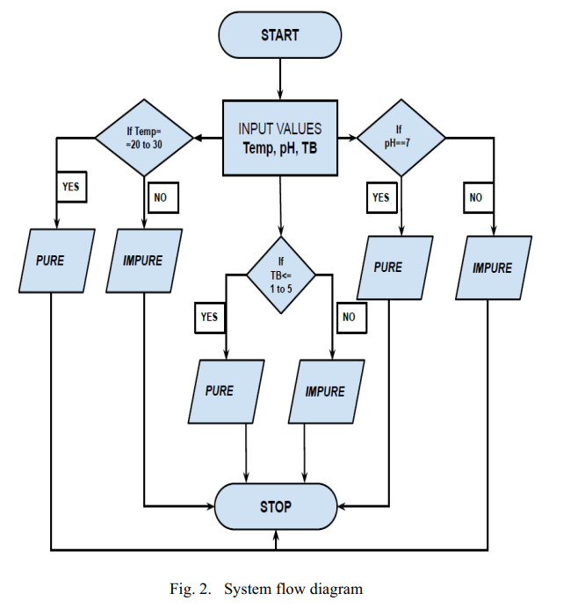

Slide 10
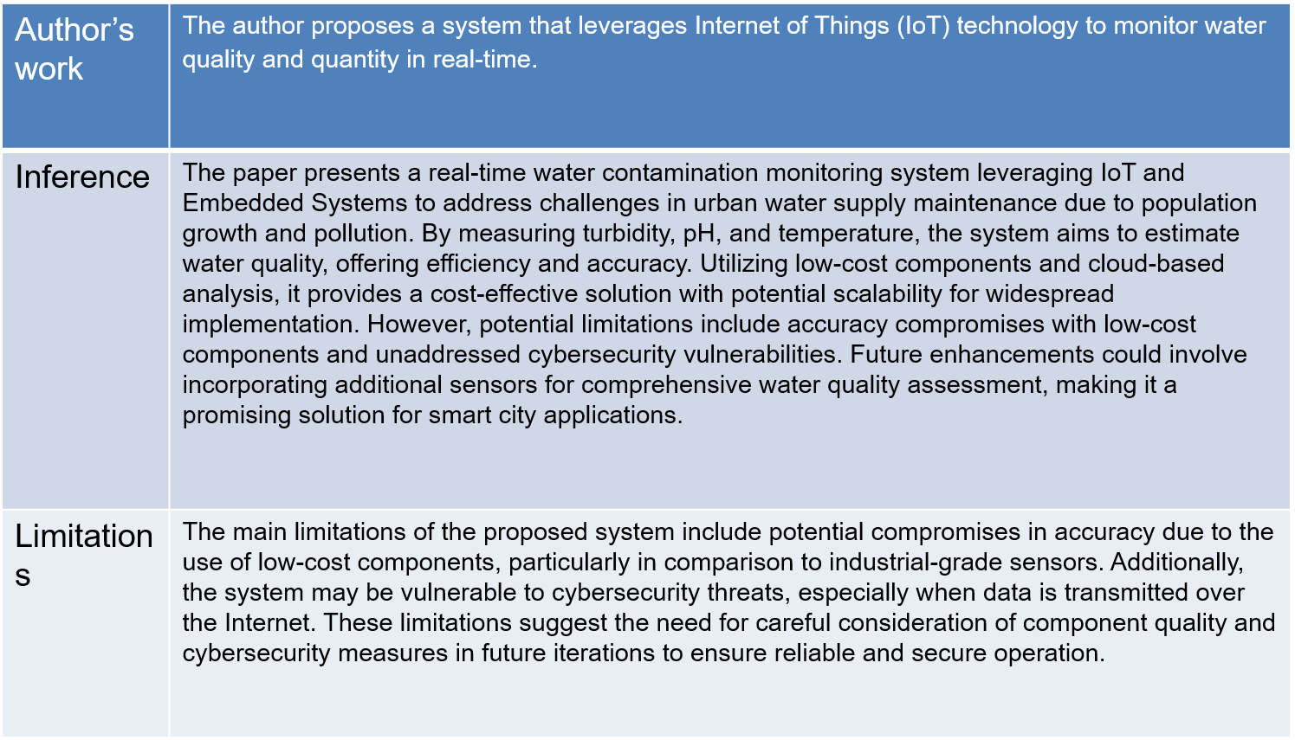
[4] M. N. Vamsi Thalatam, P. Lanka and J. N. V. R. S. Kumar, "An IoT Based Smart Water Contamination Monitoring System," 2023 International Conference on Intelligent Systems for Communication, IoT and Security (ICISCoIS), Coimbatore, India, 2023, pp. 387-391
10
10

Slide 11
[5] European Journal of Sustainable Development A methodology based on spatial distribution of parameters for understanding affect of rainfall and vegetation density on groundwater recharge Vijai Singhal and Rohit Goyal
Author’s work | The authors aim to understand the relationship between rainfall, vegetation density, and groundwater recharge.They utilize spatial distribution analysis to explore how these factors impact groundwater replenishment.
Inference | The study reveals that groundwater recharge increases with Normalized Difference Vegetation Index (NDVI) up to a certain point.Beyond that threshold, further vegetation density does not significantly enhance recharge.Additionally, the research identifies a linear correlation between groundwater recharge and rainfall
Limitations | Simplification. Data Availability Generalization Temporal Variability
11

Slide 12
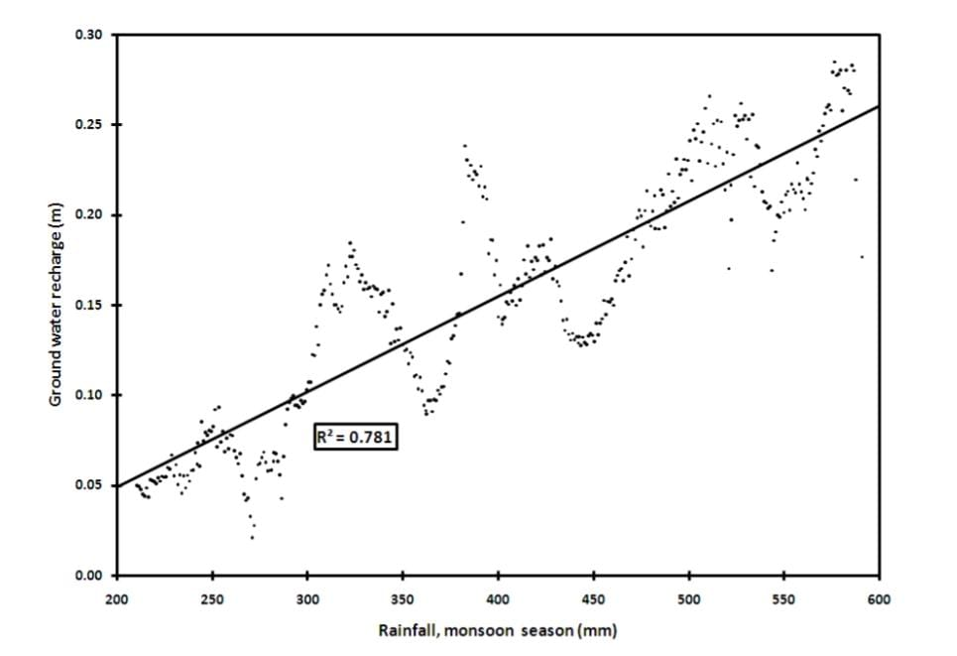
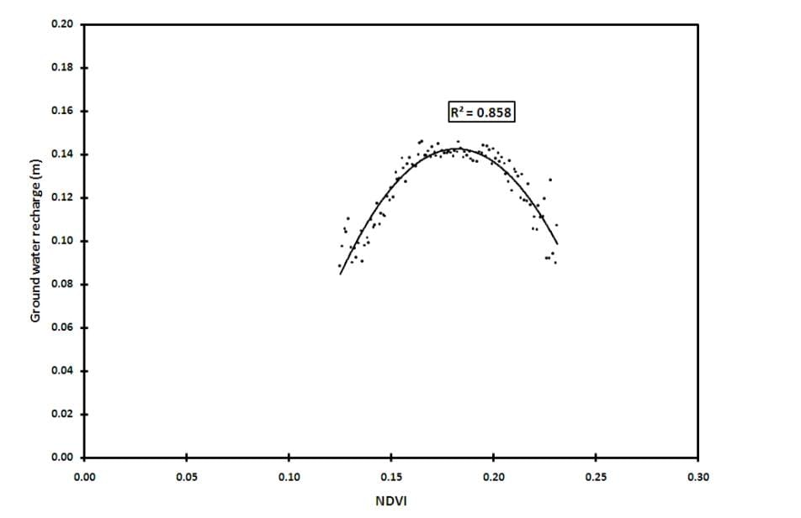

Slide 13
[6] S. H. Priyadarshini, P. S., R. P. B., V. K. V. and A. D. V A, "AQUASENSE: Sensor Based Water Quality Monitoring Device," 2023 International Conference on Self Sustainable Artificial Intelligence Systems (ICSSAS), Erode, India, 2023, pp. 1786-1789
Author’s work | Parameters Measured: The device collects water samples from different regions in Bangalore city and measures ph,turbidity
Inference | Temperature Influence: The temperature affects TDS measurements due to its impact on solubility. Affordability and Efficiency: AQUASENSE is an affordable and efficient alternative to existing water quality monitor
Limitations | Local Context: The device’s effectiveness may vary based on the specific water sources and environmental conditions in Bangalore. Calibration: Regular calibration is essential to maintain accuracy.
13

Slide 14
[7] "Study on reciprocal relationship among water amount-water quality-water efficiency based on the SWAT_WAQER model "2021 7th International Conference on Hydraulic and Civil Engineering & Smart Water Conservancy and Intelligent Disaster Reduction Forum (ICHCE & SWIDR)
Author’s work | work involves developing and applying the SWAT_WAQER model to analyze the interplay between water consumption, efficiency, and river water quality in the Yulin Basin.
Inference | How changes in water consumption and pollution emissions impact river water quality.By using the SWAT_WAQER model. The authors simulate different water conservation scenarios in the Yulin catchment. The model predicts the effects of economic water consumption and pollutants on water quality.
Limitations | Model Assumptions Simplifications Local Context External Factors
14

Slide 15
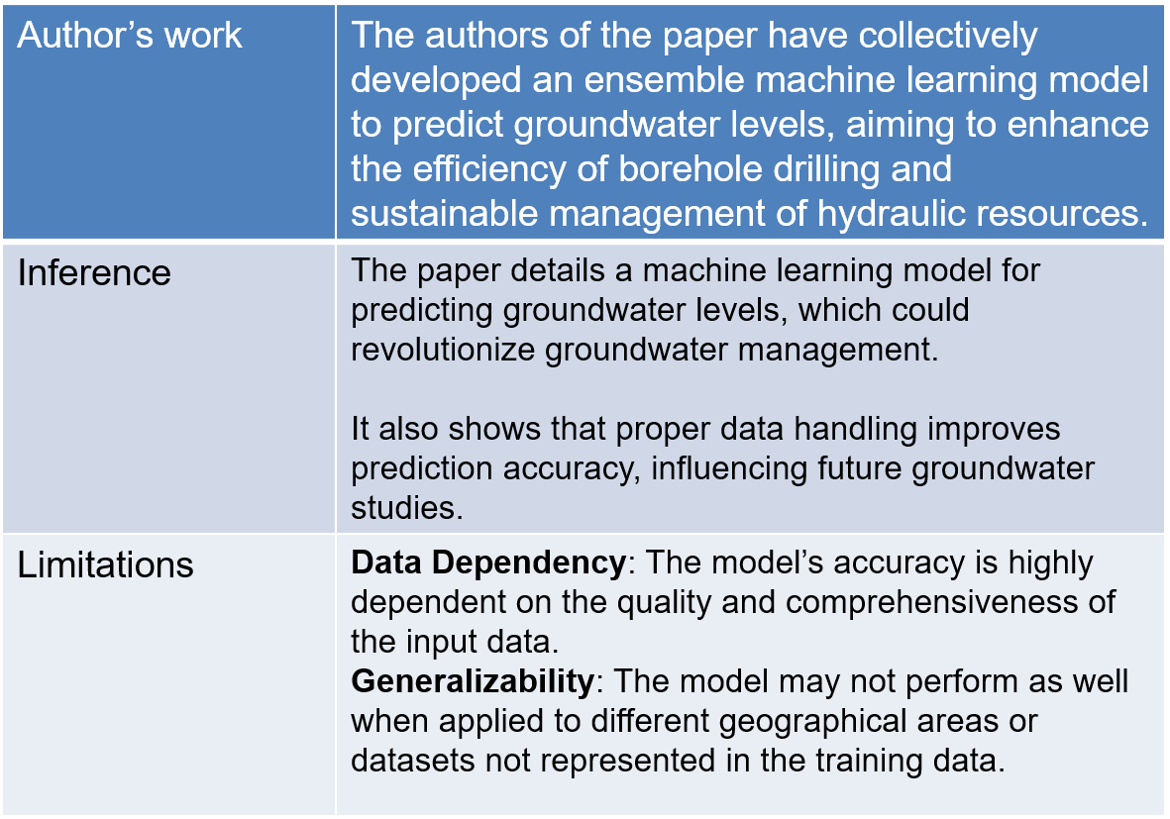
[8] N. Iqbal et al., "Groundwater Level Prediction Model Using Correlation and Difference Mechanisms Based on Boreholes Data for Sustainable Hydraulic Resource Management," in IEEE Access, vol. 9, pp. 96092-96113, 2021, doi: 10.1109/ACCESS.2021.3094735.
15
15

Slide 16
[9] M. Jafril Alam, S. Kar, S. Zaman, S. Ahamed and K. Samiya, "Forecasting Underground Water Levels: LSTM Based Model Outperforms GRU and Decision Tree Based Models," 2022 IEEE International Women in Engineering (WIE) Conference on Electrical and Computer Engineering (WIECON-ECE), Naya Raipur, India, 2022, pp. 280-283, doi: 10.1109/WIECON-ECE57977.2022.10151230.
Author’s work | The authors of the study on forecasting underground water levels using machine learning and deep learning. However, the research highlights the significance of these models in addressing water depletion and emphasizes the superior performance of LSTM-based models for time series forecasting.
Inference | The paper presents a study on forecasting underground water levels using machine learning and deep learning models, with the LSTM-based model outperforming others in accuracy.
Limitations | The paper discusses the effectiveness of various machine learning models for forecasting underground water levels, highlighting that deep learning models, particularly LSTM, outperform traditional algorithms. However, it acknowledges limitations such as the need for more diverse data and the potential development of an attention mechanism-based system for improved forecasting.
16

Slide 17
[10] M, M. G. Dinesh, C. Lakshmipriya, V. Sharmila, A. Muthuram and S. S. R, "Water Quality Prediction using Machine Learning: A Comparative Study," 2023 Second International Conference on Augmented Intelligence and Sustainable Systems (ICAISS), Trichy, India, 2023, pp. 348-353
Author’s work | The author investigates the suitability of machine learning methods such as SVM, XGBoost, Decision Trees, and K-NN for predicting water quality indicators, leveraging historical environmental data.
Inference | The study aims to propose a machine learning-based approach for forecasting the Water Quality Index (WQI) using supervised classification algorithms to achieve high accuracy. The investigation seeks to evaluate and compare the performance of different machine learning methods using a provided dataset to enhance the ability to predict water quality.
Limitations | Quality and representativeness of the dataset used, potentially affecting the generalizability of the proposed machine learning models. The effectiveness of the machine learning-based technique for seasonal variations, geographical factors, and changes in industrial activities.
17

Slide 18
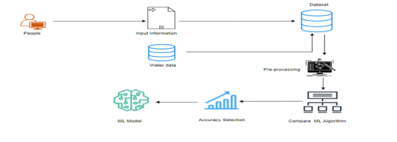
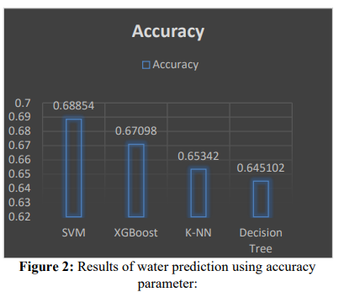
METHODOLOGY
Results

Slide 19
[11] S. K. T. K, M. Hanumanthappa, S. K. P. S and H. B. V, "Data Driven Approach to Predict Ground Water Level using Support Vector Regression," 2022 International Conference on Applied Artificial Intelligence and Computing (ICAAIC), Salem, India, 2022, pp. 01-06
Author’s work | VM-based model predicts groundwater levels and water consumption, aiding in sustainable resource management.
Inference | Geographical and climatic factors utilized to assess available water for diverse domestic needs.Data-driven approach offers insights for effective water allocation amidst growing scarcity and population demands.
Limitations | Reliance on historical data may limit predictive accuracy.Applicability may be restricted by geographical and climatic factors.
19

Slide 20
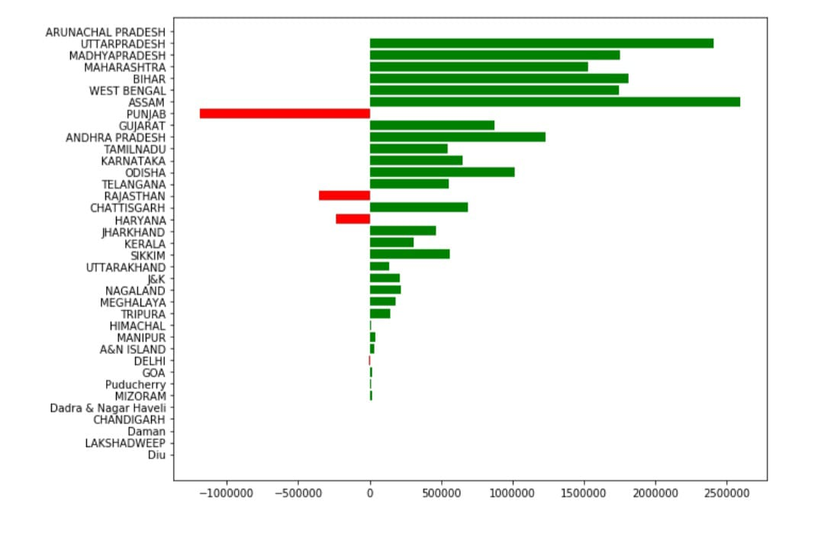
ANNUAL RESERVE OF GROUND WATER BY STATES

Slide 21
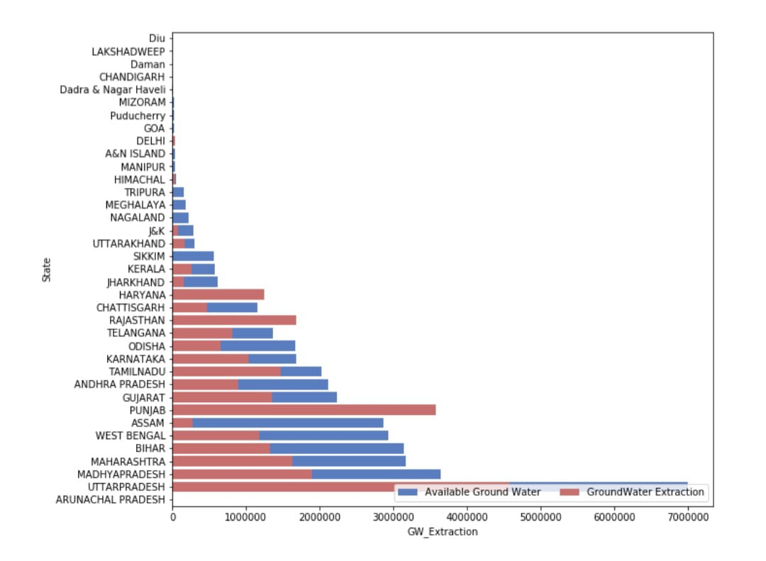
FUTURE GROUND WATER AVAILABILITY IN DIFFERENT STATES IN INDIA

Slide 22
Objectives
This project aims to detect the pollution level in the water and analyze the ground water level for safe ecosystem
Detecting Pollutants in water reservoir.
Performing real-time monitoring.
Develop an algorithm for ground water level analysis.
8/5/24
Capstone Project B.Tech 2021-25 Phase -1 ESA
22

Slide 23
Problem Statement
Monitoring Real-Time Reservoir Water Pollution Data and Analyzing Underground Water Levels for Sustainable Resource Management.
8/5/24
Capstone Project B.Tech 2021-25 Phase -1 ESA
23

Slide 24
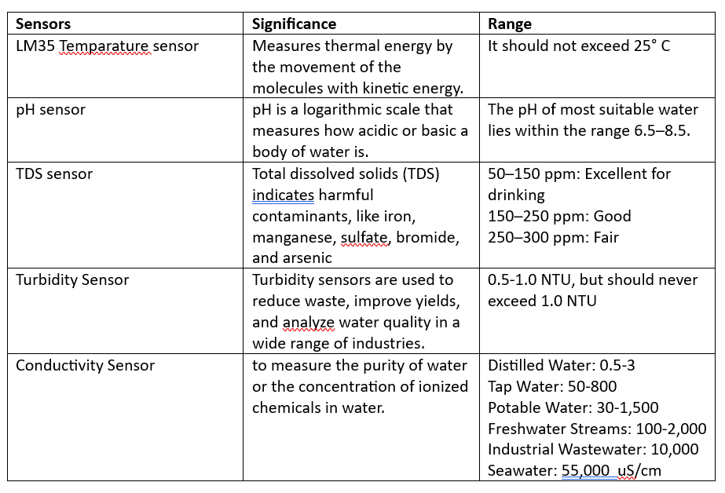
Sensor’s Information

Slide 25
Temparature Sensor
The LM35 device is rated to operate over a −55°C to 150°C
The kinetic energy results in the movement of the molecules with internal thermal energy.
It affects the concentration of the dissolved gases and the saturation of the water.
Oxygen amount, rate of photosynthesis by plants inside the water, metabolic rates of aquatic animals are adversely impacted by the increased temperature.
Source: http://ln.run/urPeC
These sensors are accurate integrated circuit temperature sensors whose output voltage is linearly proportional to the temperature of the system.
The sensor is directly calibrated in Celsius the user does not need to manually calculate the result in centigrade scaling.
This sensor is recalibrated as it does not need any external calibration to provide accurate results.
Source: http://www.state.ky.us/nrepc/water/ramp/rmtemp.htm#:~:text=Criteria:%20Water%20quality%20criteria%20for,22.2C%20(72%20F)

Slide 26
pH Sensor
A pH sensor helps to measure the acidity or alkalinity of the water with a value between 0-14
pH is a logarithmic scale that measures how acidic or basic a body of water is.
It's a crucial parameter for assessing water quality because it can affect the chemical and biological processes that occur in water bodies.
Source: https://shorturl.at/uALS3
TDS Sensor
The Gravity Analog TDS Sensor has a TDS measurement range of 0–1000 parts per million (ppm) and an accuracy of ±10% FS at 25°C
Total dissolved solids (TDS) in water can be important for water pollution
Because high levels can indicate harmful contaminants, like iron, manganese, sulfate, bromide, and arsenic. TDS can also impact the water's flavor, odor, and overall palatability.
Source: https://shorturl.at/epsJ0

Slide 27
Turbidity Sensor
The range of sensing capacity is 5 - 4000 NTU
Turbidity sensors are used to reduce waste, improve yields, and analyze water quality in a wide range of industries.
For samples with high amounts of TSS and TDS, the difference in the light intensity from the transmission beam is measured to obtain the turbidity result.
While light scattering is more suitable for samples with low amounts of TSS and TDS.
Turbidity sensors use light to detect a solution’s turbidity level, it is important to reduce the amount of external light when using the sensor.
Source: https://tinyurl.com/2ya3ryjk
Conductivity Sensor
Range: 0-9999/9.9 µS (µS/cm)
Sensor link : https://shorturl.at/nsOV1
Water conductivity sensors are used in water-quality applications to measure how well a solution conducts an electrical current. This type of measurement assesses the concentration of ions in the solution. The more ions that are in the solution, the higher the conductivity.
Source: https://tinyurl.com/3nwepf22

Slide 28
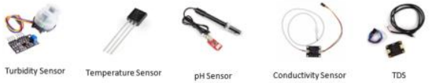

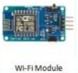


Methodology
System Architecture
8/5/24
Capstone Project B.Tech 2021-25 Phase -1 ESA
28

Slide 29
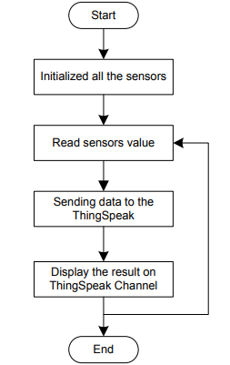
Methodology
Flow Chart of Real time Monitoring Water Pollution

Slide 30
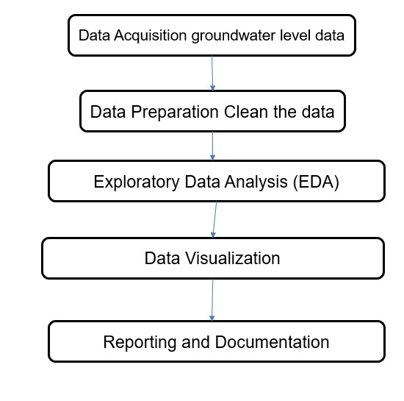
Methodology
Analysis of Ground Water Level

Slide 31
Hardware / Software Requirement
Hardware Components- Turbidity sensor, Arduino Uno, ESP 8266, Temperature sensor, pH sensor, Conductivity sensor , TDS sensor .
Software Components- ThingSpeak , Groundwater level dataset , Python.
Dataset: https://data.opencity.in/dataset/dynamic-ground-water-resources-of-karnataka-2020
OpenCity - Urban Data Portal
8/5/24
Capstone Project B.Tech 2020-24 Phase -1 ESA
31

Slide 32
Deliverables
Water Contamination detection using sensors.
Provide real time Water pollution data for user.
Analysis of ground water level and providing inputs to increase the ground water level.
8/5/24
Capstone Project B.Tech 2021-25 Phase -1 ESA
32

Slide 33
References
[1] K. Banerjee et al., "Assessing Water Quality Index Near Industrial Regions and Aiding in Effective Water Management and Controlling Water Pollution Level," 2022 5th International Conference on Contemporary Computing and Informatics (IC3I), Uttar Pradesh, India, 2022, pp. 1987-1991
[2] K. S., S. T.V., M. S. Kumaraswamy and V. Nair, "IoT based Water Parameter Monitoring System," 2020 5th International Conference on Communication and Electronics Systems (ICCES), Coimbatore, India, 2020, pp. 1299-1303
[3] Md. Jahirul Islam, Asaduzzaman, “Smart Water Quality Monitoring and Controlling System”, 5th International Conference on Electrical Information and Communication Technology (EICT), 17-19 December 2021, Khulna, Bangladesh
[4] M. N. Vamsi Thalatam, P. Lanka and J. N. V. R. S. Kumar, "An IoT Based Smart Water Contamination Monitoring System," 2023 International Conference on Intelligent Systems for Communication, IoT and Security (ICISCoIS), Coimbatore, India, 2023, pp. 387-391
8/5/24
Capstone Project B.Tech 2021-25 Phase -1 ESA
33

Slide 34
References
[5] European Journal of Sustainable Development A methodology based on spatial distribution of parameters for understanding affect of rainfall and vegetation density on groundwater recharge Vijai Singhal and Rohit Goyal
[6] S. H. Priyadarshini, P. S., R. P. B., V. K. V. and A. D. V A, "AQUASENSE: Sensor Based Water Quality Monitoring Device," 2023 International Conference on Self Sustainable Artificial Intelligence Systems (ICSSAS), Erode, India, 2023, pp. 1786-1789
[7] "Study on reciprocal relationship among water amount-water quality-water efficiency based on the SWAT_WAQER model "2021 7th International Conference on Hydraulic and Civil Engineering & Smart Water Conservancy and Intelligent Disaster Reduction Forum (ICHCE & SWIDR)
8/5/24
Capstone Project B.Tech 2021-25 Phase -1 ESA
34

Slide 35
References
[8] N. Iqbal et al., "Groundwater Level Prediction Model Using Correlation and Difference Mechanisms Based on Boreholes Data for Sustainable Hydraulic Resource Management," in IEEE Access, vol. 9, pp. 96092-96113, 2021, doi: 10.1109/ACCESS.2021.3094735.
[9] M. Jafril Alam, S. Kar, S. Zaman, S. Ahamed and K. Samiya, "Forecasting Underground Water Levels: LSTM Based Model Outperforms GRU and Decision Tree Based Models," 2022 IEEE International Women in Engineering (WIE) Conference on Electrical and Computer Engineering (WIECON-ECE), Naya Raipur, India, 2022, pp. 280-283, doi: 10.1109/WIECON-ECE57977.2022.10151230.
[10] M, M. G. Dinesh, C. Lakshmipriya, V. Sharmila, A. Muthuram and S. S. R, "Water Quality Prediction using Machine Learning: A Comparative Study," 2023 Second International Conference on Augmented Intelligence and Sustainable Systems (ICAISS), Trichy, India, 2023, pp. 348-353
8/5/24
Capstone Project B.Tech 2021-25 Phase -1 ESA
35

Slide 36
References
[11] S. K. T. K, M. Hanumanthappa, S. K. P. S and H. B. V, "Data Driven Approach to Predict Ground Water Level using Support Vector Regression," 2022 International Conference on Applied Artificial Intelligence and Computing (ICAAIC), Salem, India, 2022, pp. 01-06
8/5/24
Capstone Project B.Tech 2021-25 Phase -1 ESA
36

Slide 37
Summary
Real-Time Monitoring: Live sensor data enables real-time monitoring of water quality, allowing immediate detection and response to pollution events.
Precision and Efficiency: Utilizing live data ensures precise measurements, leading to accurate analysis of water quality and efficient water resource management.
Pollution Control: Live sensor data helps identify pollution sources and levels, facilitating targeted interventions to mitigate environmental impacts.
Groundwater Level Analysis: Understanding water resource dynamics, assessing impacts of climate change, and supporting sustainable water management.
8/5/24
Capstone Project B.Tech 2021-25 Phase -1 ESA
37

Slide 38
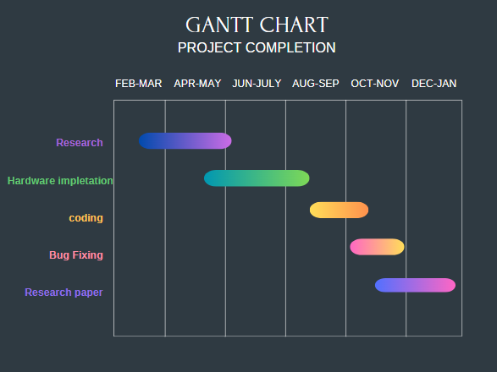
Project timeline
8/5/24
Capstone Project B.Tech 2021-25 Phase -1 ESA
38

Slide 39
Q & A
Notes:
39

Slide 40
Thank You
Notes:
40

